Slide 1
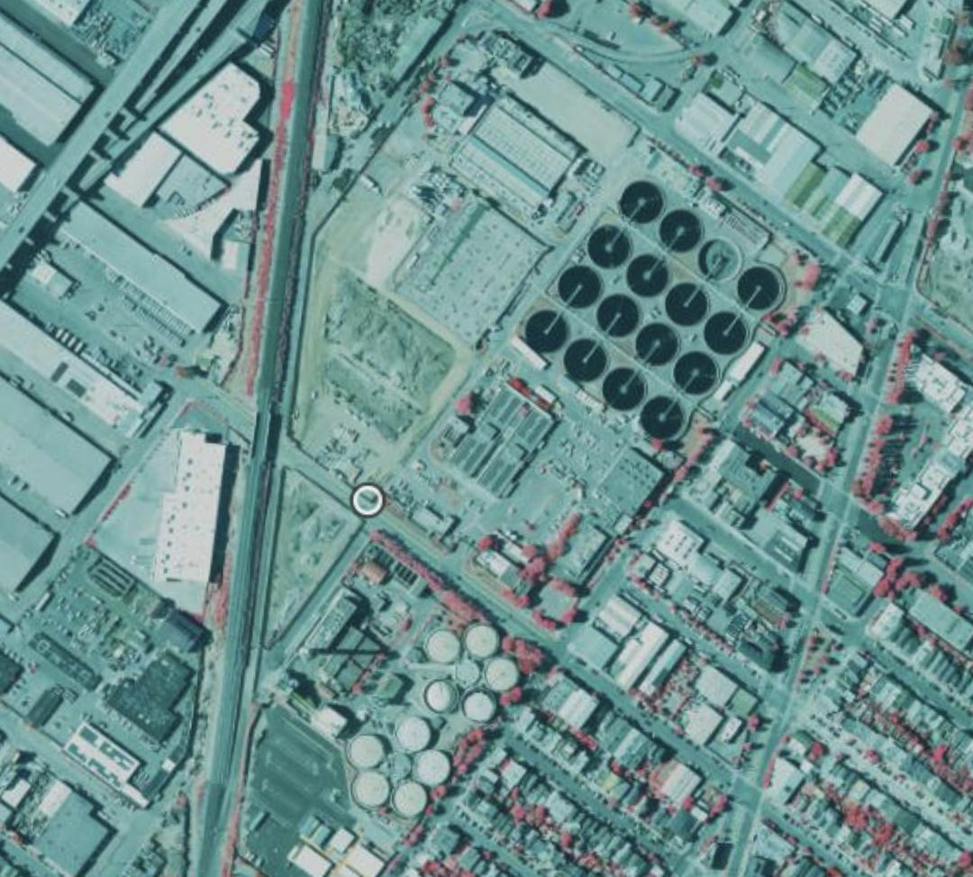
WWTP Project Update
November 3, 2023

Slide 2
Outline
Current Status
Future Plan

Slide 3
Current Status
Updated process to analyze wastewater treatment plants (WWTPs)
California Tagging Completed
Texas Images Downloaded

Slide 4
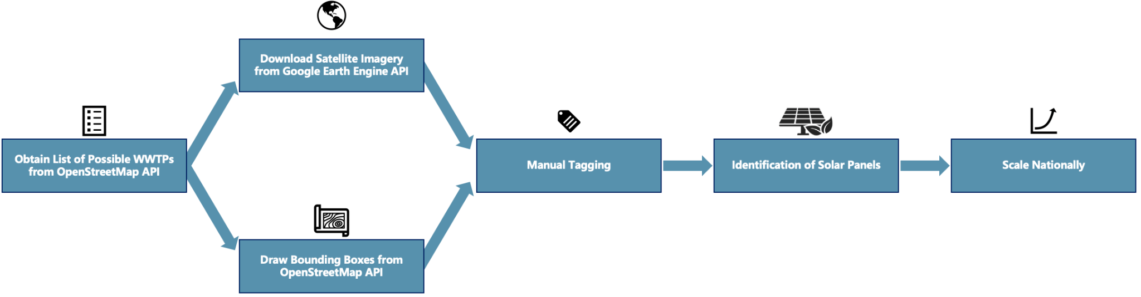
WWTP Analysis Process

Slide 5
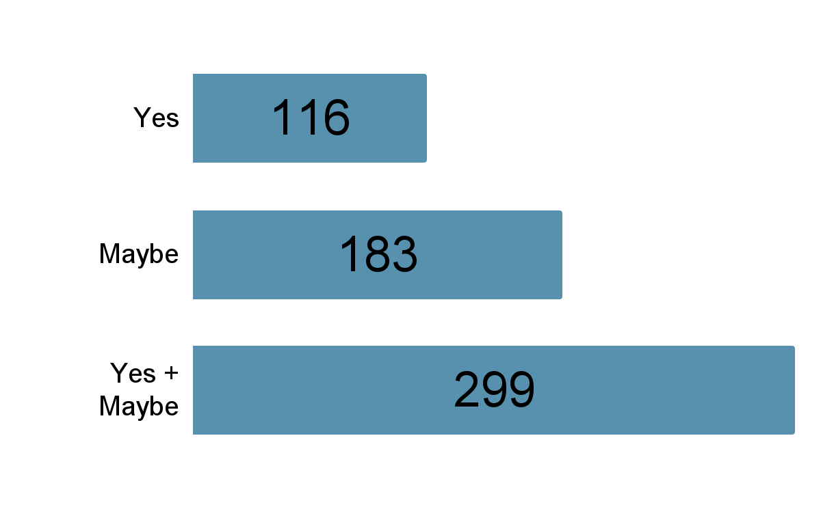
California WWTP Tagging Results
Out of 3104
Percentage Range:
3.737% ~ 9.632%
Excel Sheet:
Yes List
Yes + Maybe List

Slide 6
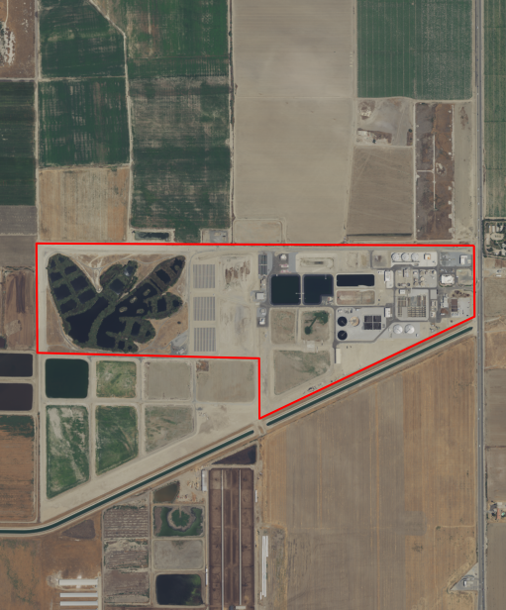
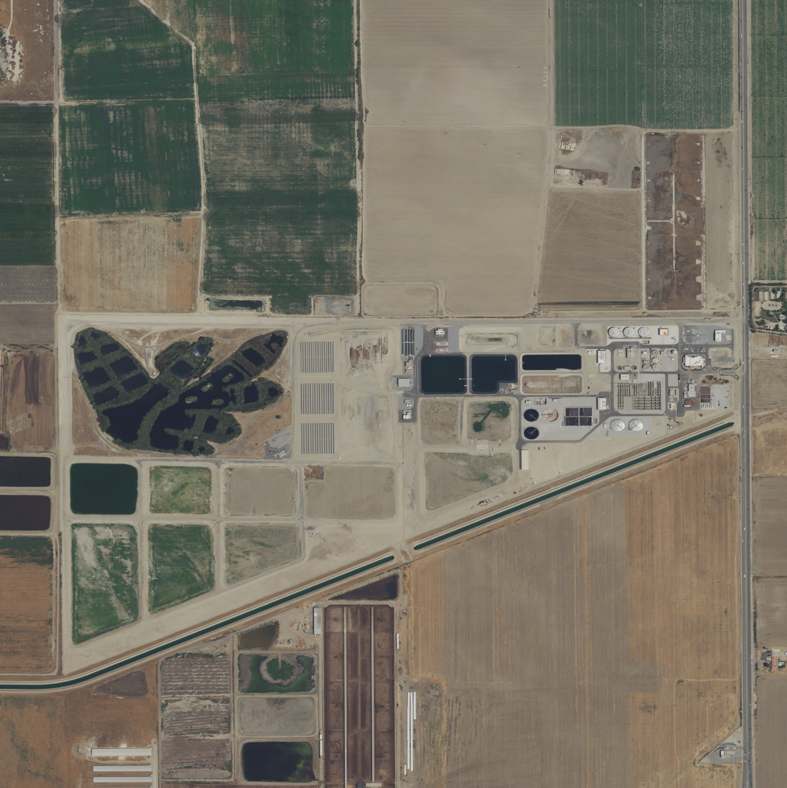
Illustrative Example of WWTP
San Jacinto Valley Regional Water Reclamation Facility.png
San Jacinto Valley Regional Water Reclamation Facility.tif

Slide 7
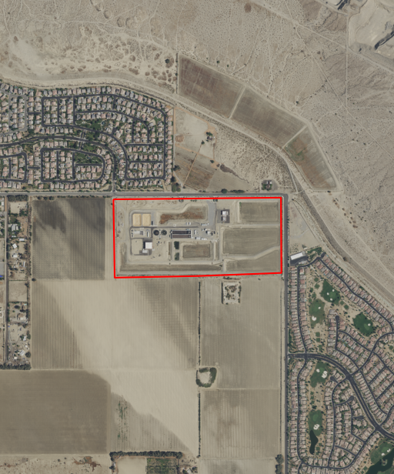
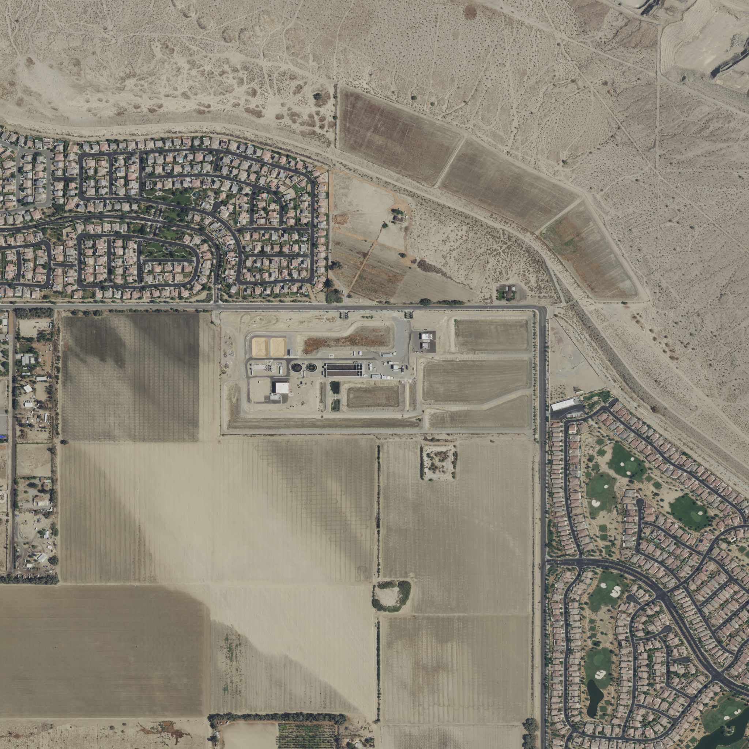
Illustrative Example of Possible WWTP
Plant_973083847.png
Plant_973083847.tif

Slide 8
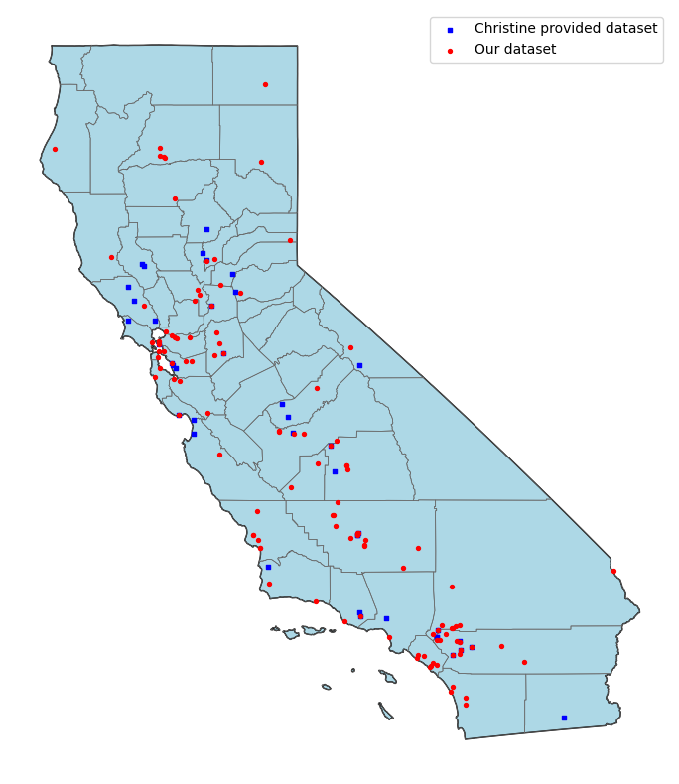
WWTP Distribution Map
Blue points: provided WWTP locations
Red points: our verified WWTP locations
Notes:
As we can see, we have missed some plants using the current pipeline

Slide 9
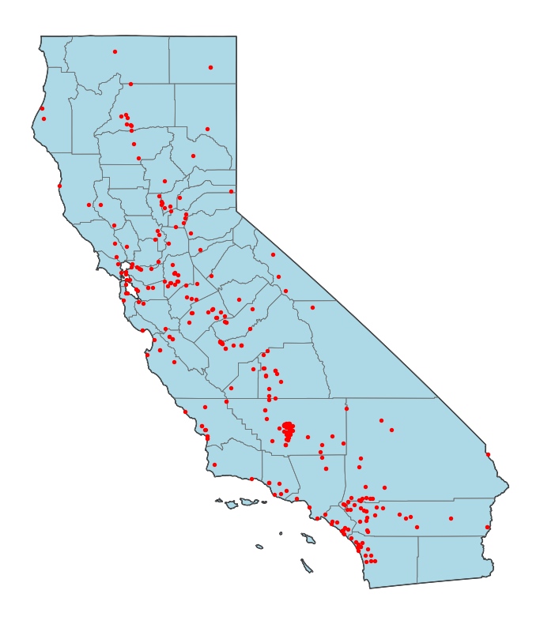
WWTP Distribution Map
Verified + Potential WWTP locations

Slide 10
WWTP Interactive Map
Distribution of verified WWTPs
Distribution of verified + potential WWTPs
(Two maps are attached in the email)

Slide 11
Challenges
Duplicate WWTP sites
Missing Verified WWTP sites
Identification of WWTP sites
There are more potential WWTPs seen compared to confirmed sites

Slide 12
Future Plan
Figure out other data sources in addition to OpenStreetMap to obtain potential WWTP sites
Figure out optimal automation strategy
Current: Manually tagging WWTPs -> Computer Vision tagging solar
Alternative: Computer Vision tagging WWTPs -> Manually tagging solar
With current pipeline
Tagging Texas
Begin plan to scale to other states
Switching to alternative pipeline
Altering downloading pipeline to include tagging process
Tag solar
Conduct second pilot on Texas
Begin plan to scale to other states

Slide 13
Current Expansion to Texas
If the Same Conversion Rate Applied to Texas:
Out of 542 Images Downloaded
Using same Percentage Range observed in California: 3.737% ~ 9.632%
WWTP Number would be 21 ~ 53

